Slide 1

Computer Graphics and Image Processing
Illumination and Shading I:
Illumination

Slide 2
Today’s Outline
Appearance of Illuminated Objects
Phong Illumination Model
Ambient Reflections
Diffuse Reflections
Specular Reflections

Slide 3
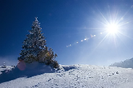
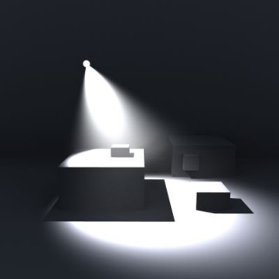
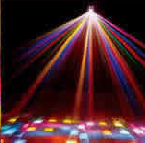
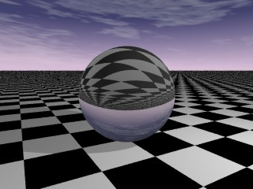
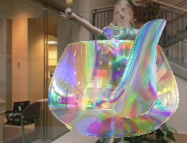
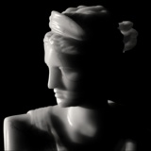
Appearance of Illuminated Objects
What we see depends on the light that makes it from the object to our eye, but lots of things can influence this
Properties of the lighting
Number of light sources
Colour of light
Direction and spread of light
Distance of light source
Properties of the surface
Light absorbtion, transmission, reflection
Complex properties leading to effects like chromatic dispersion
Properties of the environment
Objects blocking (shadows) or attenuating (fog, smoke)
Viewpoint (e.g. view in a mirror changes depending on the angle)

Slide 4
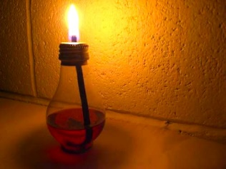
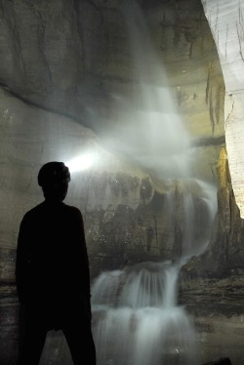
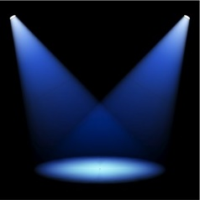
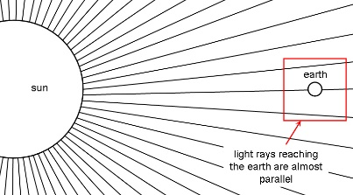
Light Sources
Point Lights (e.g. lamp, candle)
Emit light equally in all directions
Spot Lights (e.g. torch, headlamp)
Only illuminates within a fixed area
Directional lights (e.g. sun)
All points illuminated from
the same direction
No distance factor

Slide 5
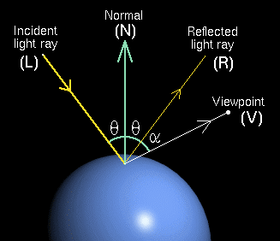
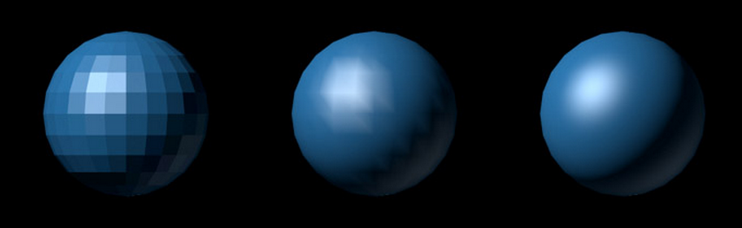
Illumination vs Shading
Illumination Model:
What colour is the surface
→ surface reflection model
Use equations from physics
(realistic, but time consuming)
… or fast approximations
(much faster, looks plausible)
Shading Model:
How do we calculate colour of pixels?
→ pixel shading algorithm
Using exact illumination model for each pixel too slow
(and often unnecessary)
Use interpolation to minimize computations of the full illumination model

Slide 6
Illumination Models
What happens to the light?
Reflection (ray bounces off surface in one direction)
Scattering (ray bounces off surface in many directions)
Absorption (ray absorbed by material)
Transmission (ray passes through object). Often includes refraction
Many surfaces apply some combination of these

Slide 7
Types of Light Reflection
In the real world:
Light reflected unlimited number of times
Each reflection changes the appearance of the light
This isn’t practical for real-time rendering
Can often calculate only one reflection per vertex
Consider different light appearances as different types of reflection
Ambient Reflection
Diffuse Reflection
Specular Reflection

Slide 8
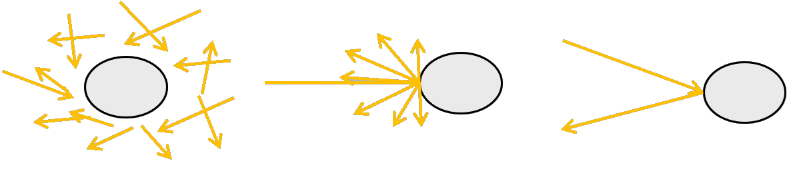
Types of Light Reflection
Ambient
Light reflected so many times, it is everywhere (like uniform background illumination
Diffuse
Light scattered from one point equally (more or less) into all directions
Specular
Light reflected more or less in only one direction (think mirror).
Type of reflection can depend on light source and object surface characteristics.

Slide 9
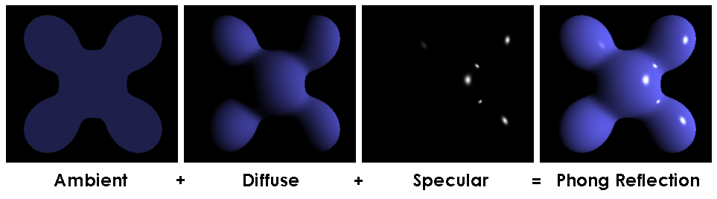
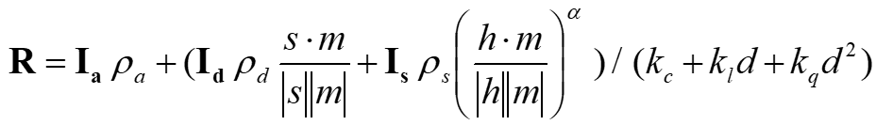
Phong Illumination Model

Slide 10
Phong Illumination Model
Invented by Dr. Bui Tuong-Phong in 1973
Idea: calculate intensity R at a point as the sum of ambient, diffuse, and specular reflection
Variables:
Light intensities I_{a}, I_{d}, I_{s} for
ambient, diffuse, and specular
Surface normal m at the illuminated point P
Vector s direction to light source
Distance d to light source
Vector v direction to viewer
Reflection coefficients of the surface ρ_{a}, ρ_{d}, ρ_{s}
I
m
v
s
d
P
ρ
s = Light – P
d = |s|
v = Viewer - P

Slide 11
Final Phong Illumination Equation
Achromatic Version:
Chromatic Version

Slide 12
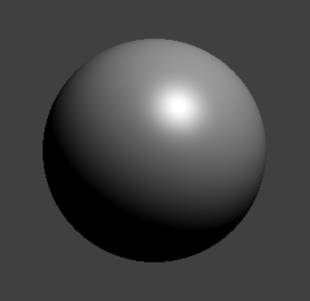
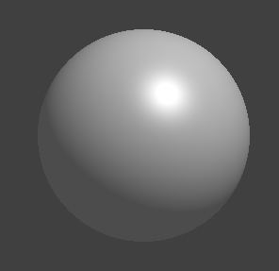
Ambient Reflection
Source: No single point or directional source
Direction of reflection: All directions (it is scattered everywhere)
R_{a}
R_{a}
I_{a}
ρ_{a}
R_{a}
R_{a}
d
Angle between v and m
No ambient light
(but still diffuse + specular)
A lot of ambient light
(and diffuse + specular)

Slide 13
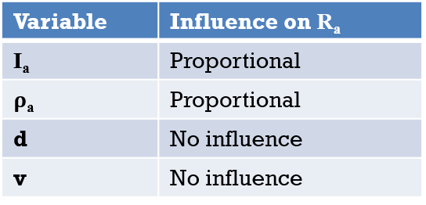
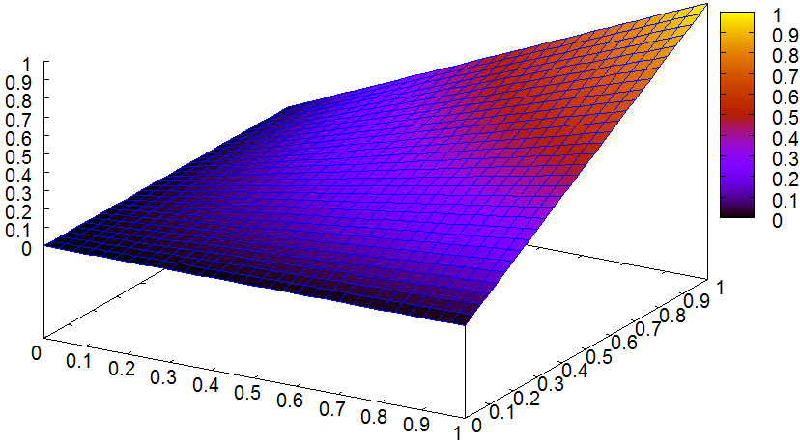
Ambient Reflection
We construct an equation for R_{a}:
How to deal with colours (RGB)?
3 equations, one for each colour:
Compute colours individually
R_{a}
ρ_{a}
I_{a}

Slide 14
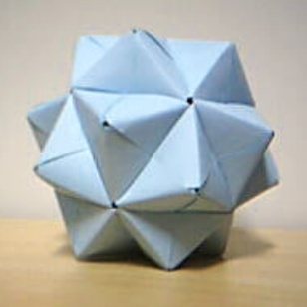
Diffuse Reflection
Source: One or more point/directional light sources
Direction of reflection: all directions (it is scattered everywhere
R_{d}
R_{d}
Object Surface under microscope
I_{d}
ρ_{d}
R_{d}
R_{d}
R_{d}
Angle between s and m
Angle between v and m
d

Slide 15
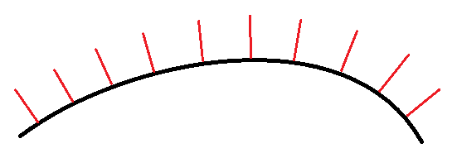

Surface Normal (m)
The unit vector pointing directly out from the surface
Uniform over a flat surface
Variable over a curved surface
The illumination calculation deals with a normal at a single point on the surface

Slide 16
Lambert’s Law
Why does R_{d} depend on the angle between s and m?
R_{d} proportional to incoming I_{d} per unit area
Rays spread over larger area means less reflection per unit area
I_{d} in unit area (1)
I_{d} in unit area (1)
m
m
s
.
θ
θ
θ
a
a
At angle 0 between s and m, rays hit area of the same size, i.e. a=1 and R_{d} ~ I_{d}
At angle θ between s and m, rays hit area a of the size 1/cos(θ)

Slide 17
Distance from Light Source
In the real world
Intensity of light from a point source decreases quadratically with d, i.e. divide intensity by d²
Area through which the rays pass grows quadratically with d
In CG:
Dividing intensity by d2 would make intensities too small
CG “hack” is to divide by (k_{c} + k_{l}d + k_{q}d²)
k_{c}, k_{l}, k_{q} are magic numbers chosen to make the scene look good

Slide 18
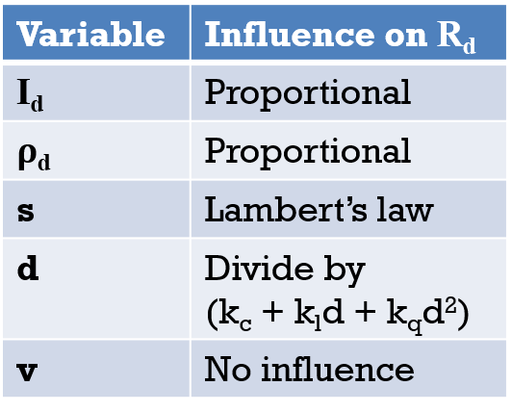
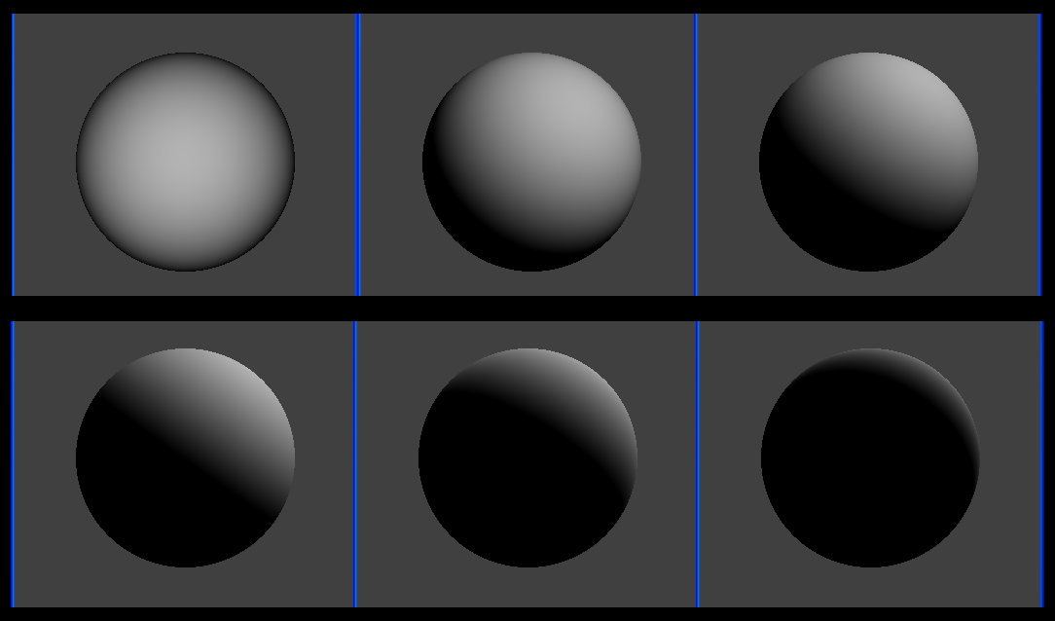
Diffuse Reflection
We construct an equation for R_{d}:
We handle colours the same way as ambient reflection: one equation for each colour, with specific I_{d} and ρ_{d}
Lambertian spheres (diffuse reflectors)

Slide 19

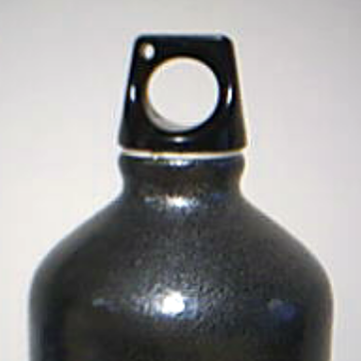
Specular Reflection
Source: One or more point/directional light sources
Direction of reflection: just one, or very little scattering
r is calculated from s and m
R_{s}
R_{s}
s
m
I_{s}
ρ_{s}
v
R_{s}
r
R_{s}
Angle between v and r
d

Slide 20
Specular Highlight
Angle φ between v and r:
Looking directly into ray (0°) = very bright
Brightness falls off quickly as eye moves away from ray
Result: Bright spot (highlight) where light reflects directly into eye
Model as cosine function
R_{s} grows with
R_{s} is always positive, so
if cos() < 0, R_{s} = 0

Slide 21
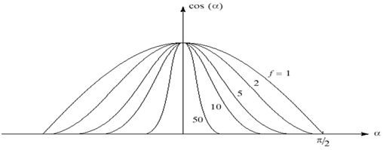
Shininess α
Some materials (e.g. mirror) reflect
almost perfectly
Others scatter slightly, but roughly
in the same direction
Shinier = less scattering = more focused specular highlight

Slide 22
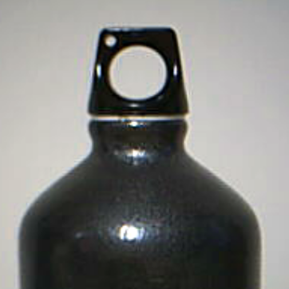
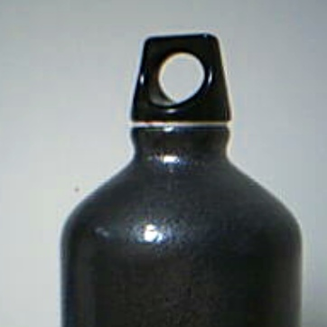
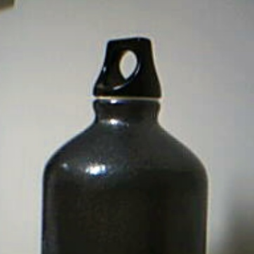
Specular Reflection
Variable | Influence on R_{s}
I_{s} | Proportional
ρ_{s} | Proportional
r and v | Highlight intensity
α | Highlight size
d | Divide by (k_{c} + k_{l}d + k_{q}d²)
We construct an equation for R_{s} :
(r is calculated from s and m)
Once again, 3 colours = 3 equations using (I_{sr}, I_{sg}, I_{sb} and ρ_{sr,} ρ_{sg,} ρ_{sb}

Slide 23
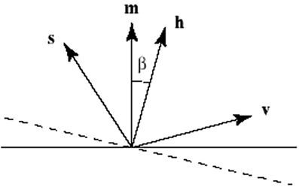
Optimising Specular Reflection
Instead of calculating r, calculate simple halfway-vector h
Use angle between h and m instead of r and v
Not mathematically identical, but similar properties
If h is exactly on m (0°) then reflection
directly into eye (r on v)
Greater angle between h and m
= greater angle between r and v
Used by OpenGL
with h = normalized(normalized(s) + normalized(v)) (→ h is half way between s and v)

Slide 24
Final Phong Illumination Equation
R_{d}
R_{s}
R_{a}
I_{a}
Angle between s and m
Angle between v and r
Specular highlight for different shininess α
s
m
R_{d,s}
v
d

Slide 25
Final Phong Illumination Equation
Achromatic Version:
Chromatic Version

Slide 26
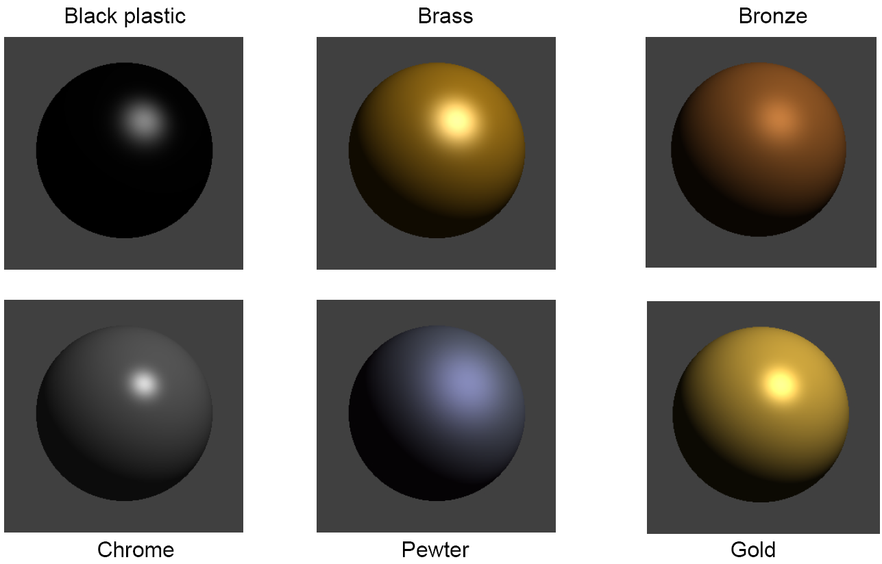
Phong Illumination
© Hill, 2nd Edition, Fig. 8.17

Slide 27
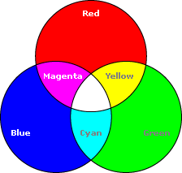
Quiz
Assume we only have ambient light:
How does the perceived colour change with different light colours and material properties?
Light colour red, Material colour red => ?
Light colour white, Material colour red => ?
Light colour red, Material colour blue=> ?
Light colour yellow, Material colour cyan=> ?
Light colour cyan, Material colour yellow => ?
Light colour yellow, Material colour blue => ?

Slide 28
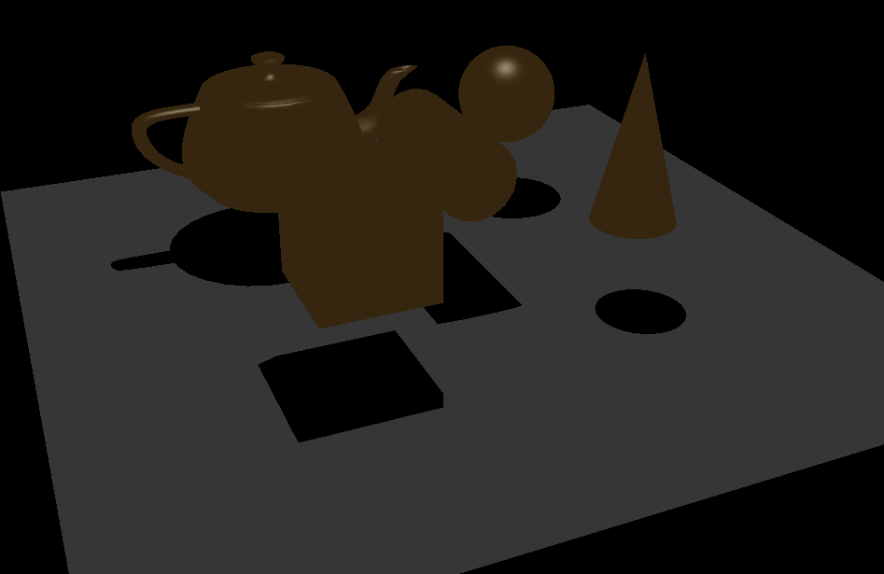
Quiz (2018 exam question)
What types of reflection are present in the scene below?

Slide 29
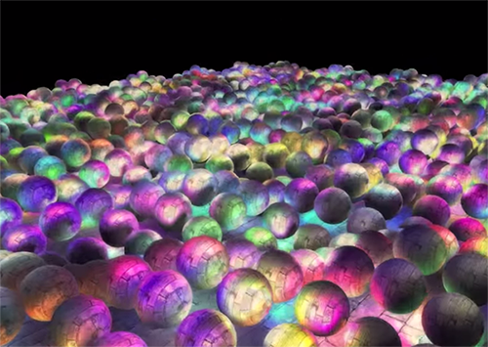
Quiz
Why does the view direction not matter for diffusely reflected light?
What does Lambert’s law say? Where do we use it?
What does the shininess parameter α do?

